Slide 1

Inbox Zero
action-based email
Original content written by: Merlin Mann
Notes:
Inbox Zero a term coined from a Merlin Mann’s series of blog post.

Slide 2

Email was a party!

Slide 3
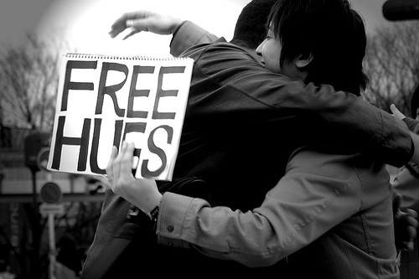
Notes:
Early days of email, it was fun
You connected with a dozen of your friends
You didn’t really need a system to keep up with the hand full of emails you would receive
Somewhere along the way email became the de-facto way knowledge works communicated.

Slide 4

Notes:
Early days of email, it was fun
You connected with a dozen of your friends
You didn’t really need a system to keep up with the hand full of emails you would receive
Somewhere along the way email became the de-facto way knowledge works communicated.

Slide 5

Notes:
Today we have tons of email slamming our inbox everyday.
How many feel they live their life in their inbox?
It is less like a party and more like a work out at the gym.

Slide 6
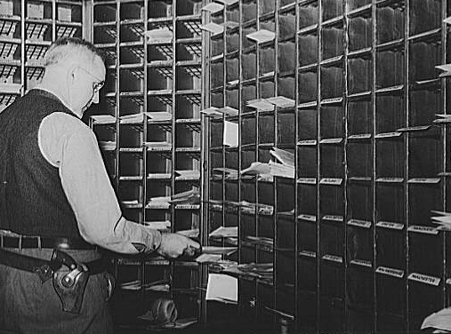
Notes:
Many have developed ways of handling the large amount of email
Many are simple to start but grow to the over complicated
Most important assets for Knowledge works is Time & Attention
Your time is finite, demands on your time are infinite

Slide 7

Notes:
Today we have tons of email slamming our inbox everyday.
How many feel they live their life in their inbox?
It is less like a party and more like a work out at the gym.
Many have developed ways of handling the large amount of email
Many are simple to start but grow to the over complicated
Most important assets for Knowledge works is Time & Attention
Your time is finite, demands on your time are infinite

Slide 8
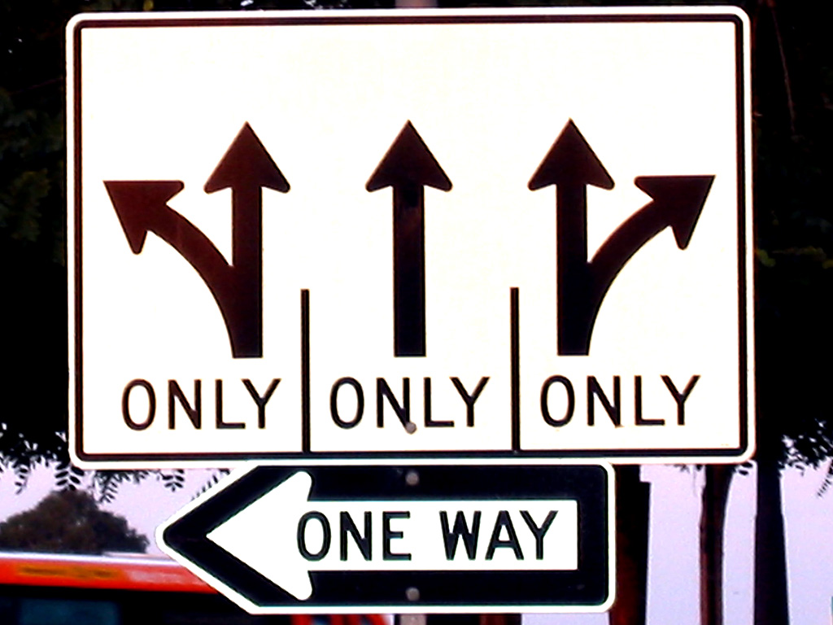

Slide 10
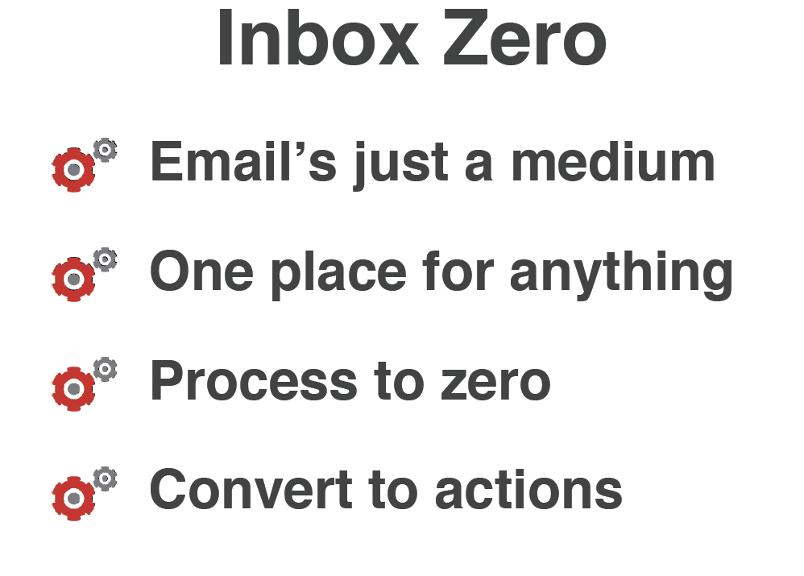

Slide 11


Slide 12
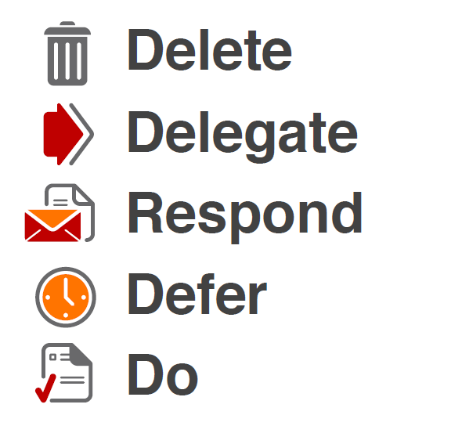

Slide 13


Slide 14


Slide 15


Slide 16


Slide 17


Slide 18
